Slide 1
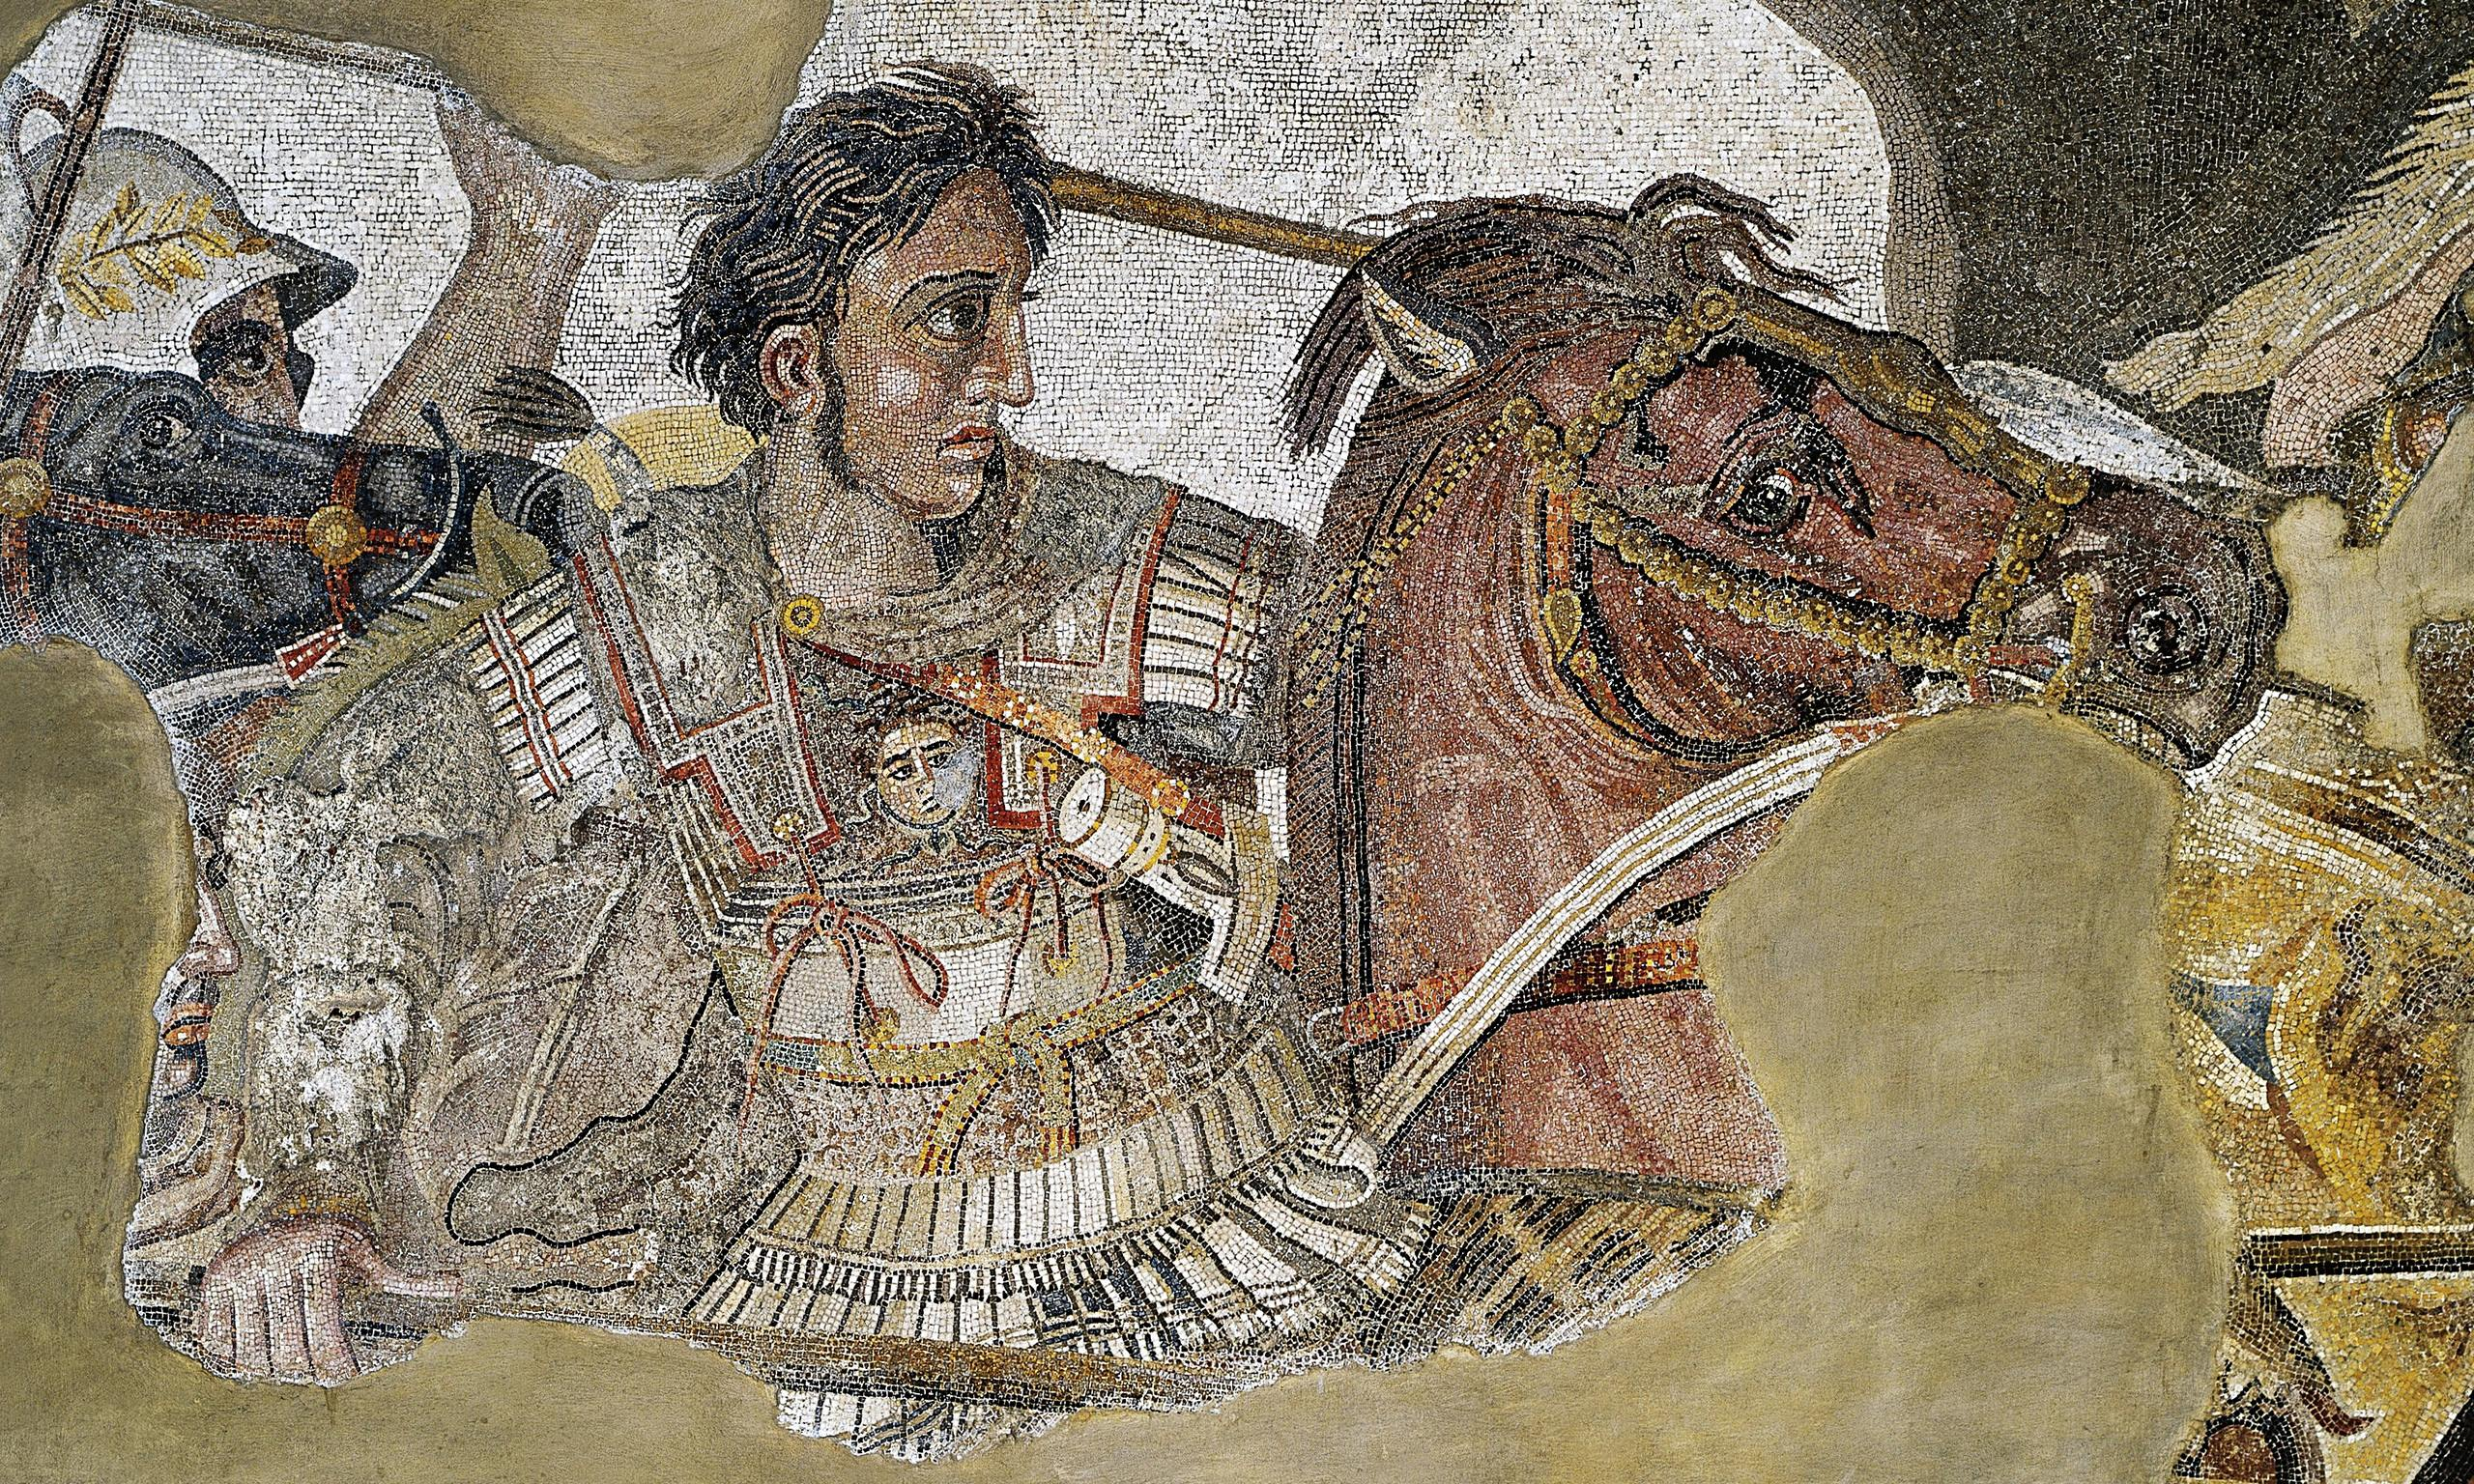
REVISION – Source Analysis
Goal/s:
Revise for source analysis task 1
Week 3 Lesson 1 – unit 2
Ms Barrie

Slide 2
Tuesday Revision
Source analysis table

Slide 3
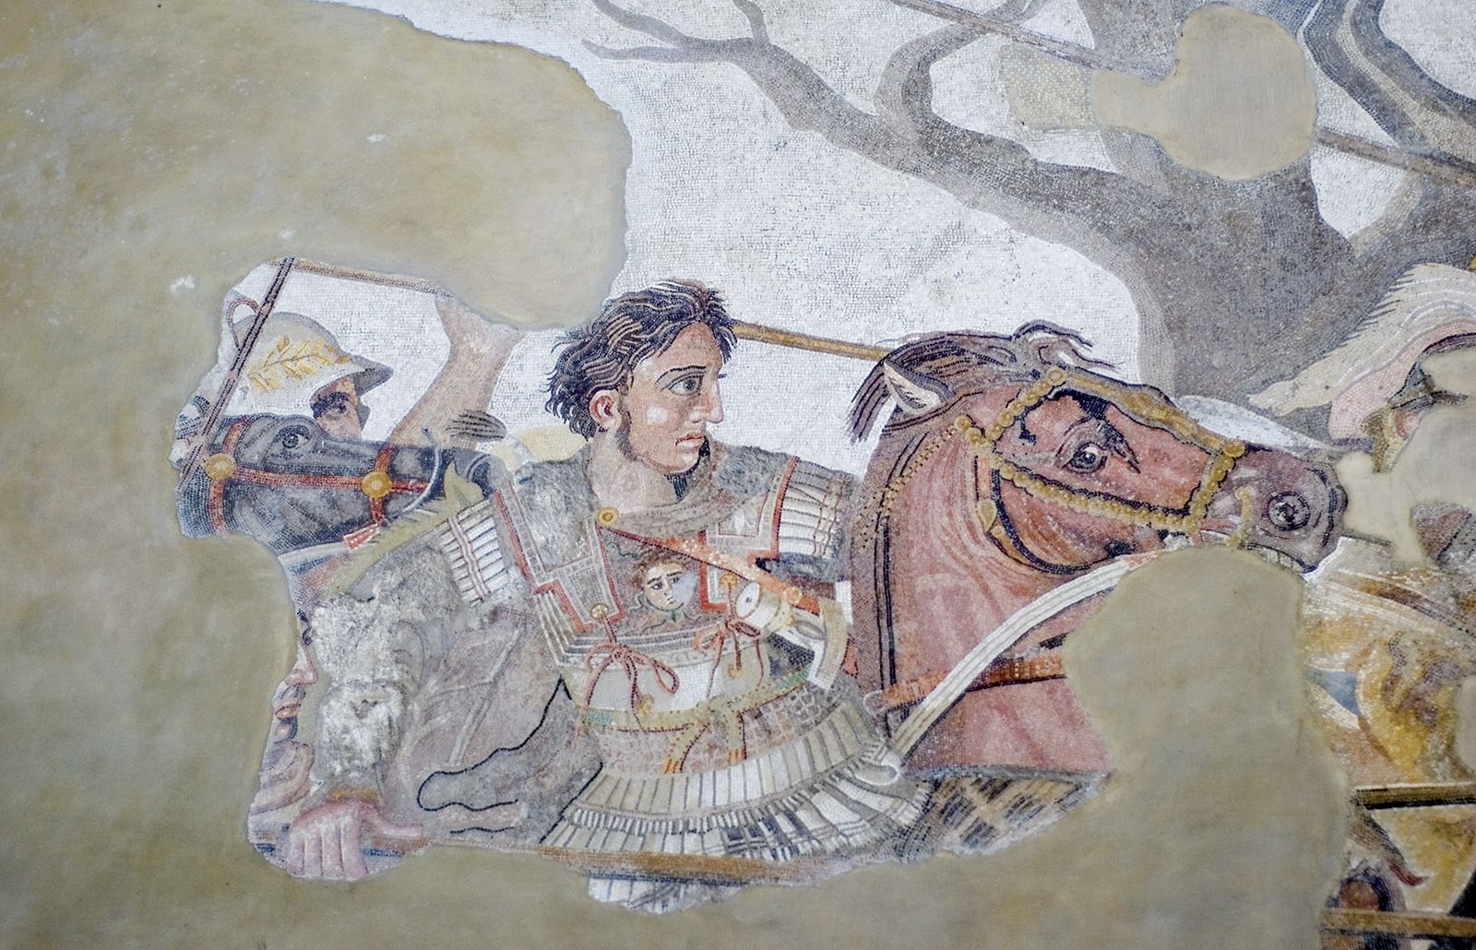
Source 1
Mosaic of Alexander the Great discovered in the House of the Faun, Pompeii, Italy.

Slide 4
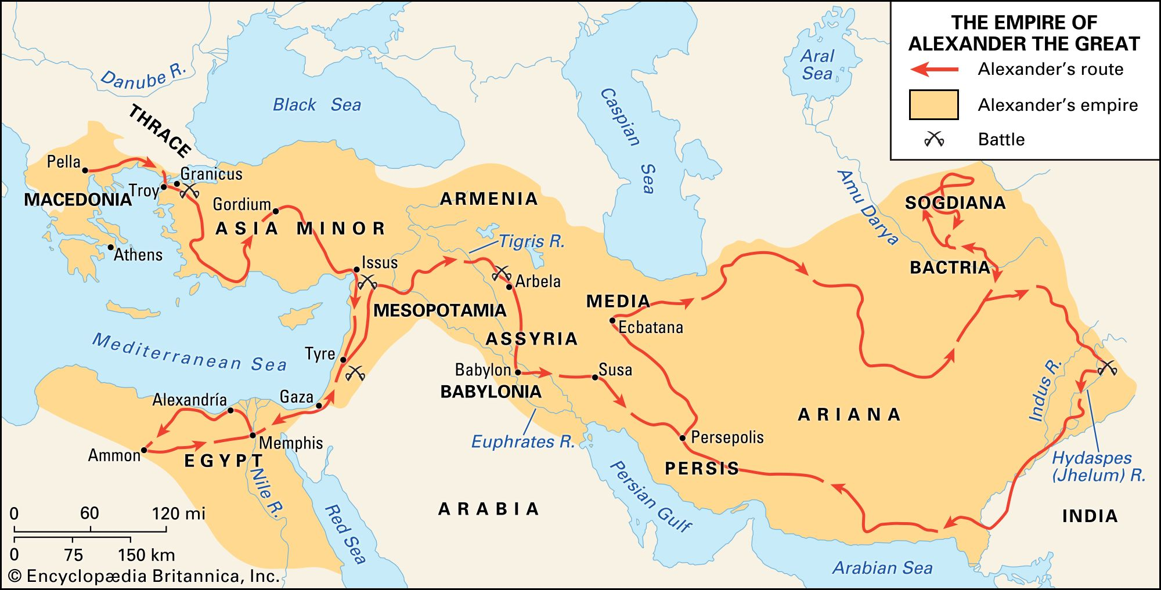
Source 2
Alexander the Great's conquests freed the West from the menace of Persian rule and spread Greek civilization and culture into Asia and Egypt. His vast empire stretched eastward into India.

Slide 5
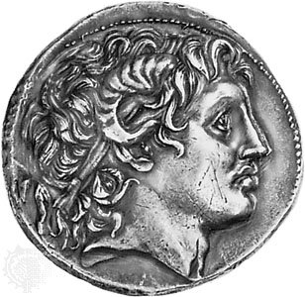
Source 3
Alexander the Great, portrait head on a coin of Lysimachus (355–281 BCE); in the British Museum, London, England.
Notes:
Lysimachus was a Thessalian officer and successor of Alexander the Great, who in 306 BC, became King of Thrace, Asia Minor and Macedon

Slide 6
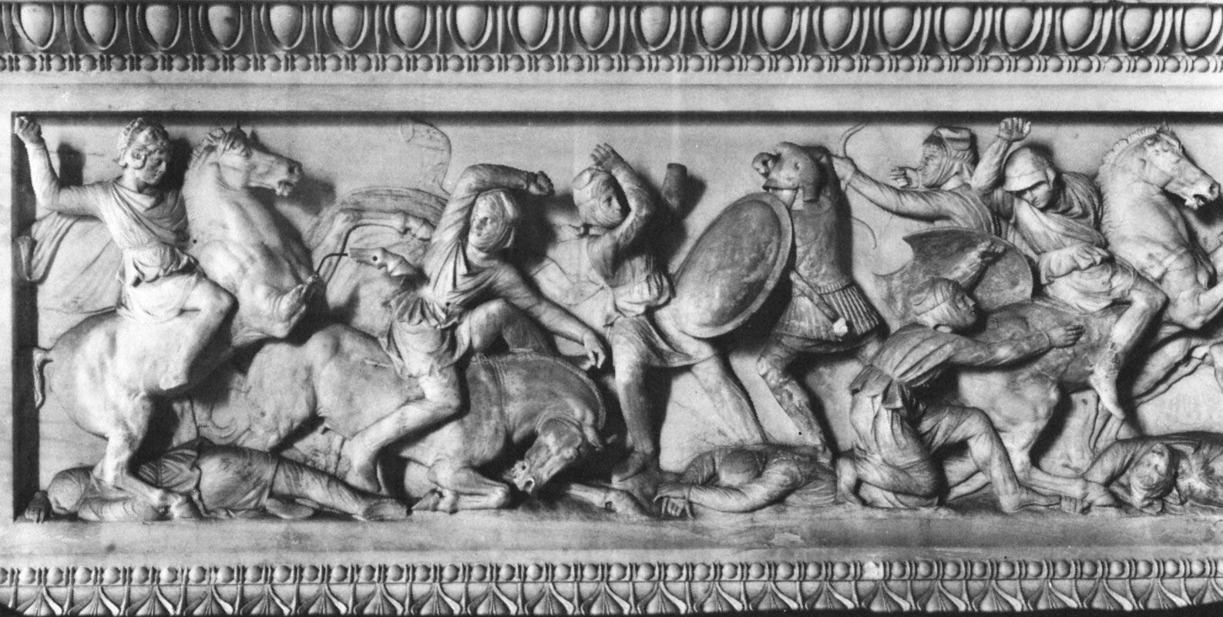
Source 4
Alexander the Great in battle, detail from the so-called Alexander Sarcophagus, marble, c. 310 BCE, from Sidon; in the Archaeological Museums of Istanbul.

Slide 7
ACTIVITY – Source Responses
Write responses to each question for ONE source as a class ____________________________________________________________________________________________________________________________________________________________________________________________________________________________________________________________________________________________________________________________________________________________________________________________________________________________________________________________________________________________________________________________________________________________________________________________________________________________________________________________________________________________________________________________________________________________________________________________________________________________________________________________

Slide 8
Wednesday Revision
Final lesson of revision!

Slide 9
Class Discussion
Positive Impacts | Negative Impacts | Short Term Impacts | Long Term Impacts | CONTINUED? | CHANGED?

Slide 10

Revision Sheet
Overview of topics/questions

